Slide 1
Koalas - An interface for Pandas User to Leverage Spark Framework
Speaker: Hsu, Li-ho

Slide 2

About me
Working on data engineering in a manufacturing company.
A data Engineer who focuses on data ingestion in Hadoop ecosystem.
Interested in reading technical books and try new technologies.

Slide 3
Outline
Scenario
Koalas
Syntax comparison
Performance
How Koalas dataframe implement?
Koalas Architecture
InternalFrame
Demo
Recap
Q&A

Slide 4


Scenario
“We saw many data scientists encountered difficulties to run their analysis with a large scale of data sets.”
Pandas
Easy to start with
Huge community
Enormous API for data manipulation
Integration with visualization, ML tools.
Restricted to single machine
DS write a bunch of models and codes in pandas.
Told to productionize the prototype, wrangling data in scale.
Why should we care about data scale?
Large data + simple algorithms = better models (Link)
References:
koalas-pandas-on-apache-spark
Icons made https://www.flaticon.com/authors/freepik"
Icons made https://www.flaticon.com/authors/freepik
Icons made https://www.flaticon.com/authors/eucalyp

Slide 5
Scenario
“We saw many data scientists encountered difficulties to run their analysis with a large scale of data sets.”
Spark
De facto unified analytics engine for large-scale data processing
Distributed
Performance working at scale
More complicated to implement data wangling
DS write a bunch of models and codes in pandas.
Told to productionize the prototype, wrangling data in scale.
Why should we care about data scale?
Large data + simple algorithms = better models (Link)
References:
koalas-pandas-on-apache-spark
Icons made https://www.flaticon.com/authors/freepik"
Icons made https://www.flaticon.com/authors/freepik
Icons made https://www.flaticon.com/authors/eucalyp

Slide 6

Scenario
“We saw many data scientists encountered difficulties to run their analysis with a large scale of data sets.”
DS write a bunch of models and codes in pandas.
Told to productionize the prototype, wrangling data in scale.
Struggling and frustrated as all other distributed systems
Why should we care about data scale?
Large data + simple algorithms = better models (Link)
References:
koalas-pandas-on-apache-spark
Icons made https://www.flaticon.com/authors/freepik"
Icons made https://www.flaticon.com/authors/freepik
Icons made https://www.flaticon.com/authors/eucalyp

Slide 7
Scenario - Syntax comparison
 | Pandas | Pyspark
Column | pdf[‘col’] | sdf[‘col’]
Add a column | pdf[‘c’] = pdf[‘a’] + pdf[‘b’] | sdf.withColumn(‘c’, sdf[‘a’] + sdf[‘b’])
Rename columns | pdf.columns[‘a’, ‘b’] | sdf.select(sdf[‘c1’].alias(‘a’), sdf[‘c2’].alias(‘b’))
Value count | pdf[‘col’].value_counts() | sdf.groupBy(sdf[‘col’]).count().orderBy(‘count’, ascending=False)
Categorical data | pd.get_dummies(pdf, columns=[‘col_name’]) | categories = spkdf_train.select(‘col_name’).distinct().rdd.flatMap(lambda x: x).collect() exprs = [F.when(F.col(‘col_name’) == category, 1).otherwise(0).alias(‘col_name’+category) for category in categories] sprkdf_train = sprkdf_train.select(exprs+sprkdf_train.columns)

Slide 8

Koalas
2019.04.24
Announced by databricks company
API coverage about 15%
Bi-weekly release
2020.06.24
Release Koalas 1.0
API coverage close to 80%
Broader plotting support
Spark accessor
Transform and Appy
“A open source project that augments Pyspark’s DataFrame API to make it compatible with pandas.”
Now

Slide 9
Koalas - Syntax comparison
Pandas, Koalas and Pyspark dataframe
 | Pandas | Koalas | Pyspark
Column | pdf[‘col’] | kdf[‘col’] | sdf[‘col’]
Add a column | pdf[‘c’] = pdf[‘a’] + pdf[‘b’] | kdf[‘c’] = kdf[’a’] + kdf[‘b’] | sdf.withColumn(‘c’, df[‘a’] + df[‘b’])
Rename columns | pdf.columns[‘a’, ‘b’] | kdf.columns[‘a’, ‘b’] | sdf.select(sdf[‘c1’].alias(‘a’), sdf[‘c2’].alias(‘b’))
Value count | pdf[‘col’].value_counts() | kdf[‘col’].value_counts() | sdf.groupBy(sdf[‘col’]).count().orderBy(‘count’, ascending=False)
Categorical data | pd.get_dummies(pdf, columns=[‘col_name’]) | ks.get_dummies(kdf, columns=[‘col_name’]) | categories = sdf.select(‘col_name’).distinct().rdd.flatMap(lambda x: x).collect() exprs = [F.when(F.col(‘col_name’) == category, 1).otherwise(0).alias(‘col_name’+category) for category in categories] sdf = sdf.select(exprs+sprkdf_train.columns)

Slide 10
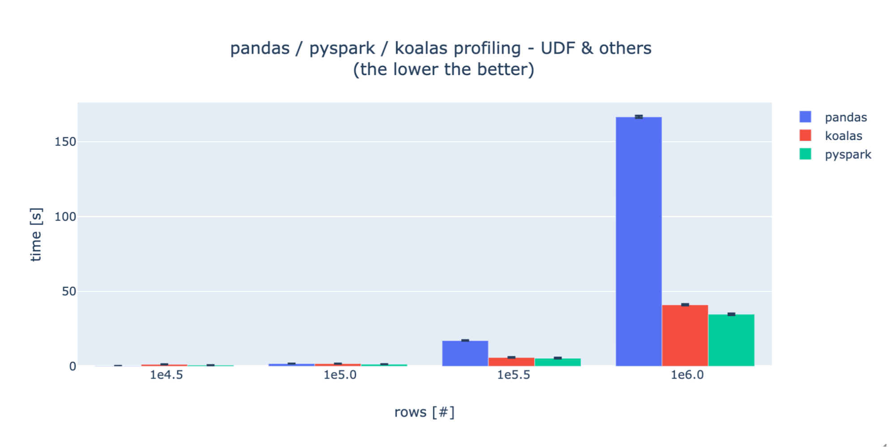
Koalas - Performance
How Virgin Hyperloop One Reduced Processing Time from Hours to Minutes with Koalas

Slide 11
How Koalas dataframe implemented?

Slide 12
Koalas - Architecture
Bridge between Pandas and Spark.
Having the scalable advantage and related attribute of Spark in nature.
Koalas
Spark
Pandas
SQL
DataFrame APIs
Catalyst Optimization
&Tungsten Execution
Data Source Connectors
Core
Reference: Koalas: Pandas on Apache Spark

Slide 13
Koalas - InternalFrame
Spark DataFrame is where data really located.
Internal Frame maintain column names and index mapping between Koalas dataframe and Spark dataframe.
Koalas DataFrame
Internal Frame
Spark DataFrame

Slide 14
Demo
Import Koalas and Essential Packages
Load data from csv file
Plot Functions
Data Wrangling
Transformation
Outliers
Missing Values
Data Type
Apply Functions
Dummy Columns
Spark Related
Link of Demo Notebook

Slide 15
Recap
Koalas is
A open source project that augments Pyspark’s DataFrame API to make it compatible with pandas.
Koalas purpose for
pandas users who want to scale out using PySpark and potentially migrate codebase to PySpark.
Spark users who want to leverage Koalas to become more productive.
Further
To be proficient in Koalas, users would need to understand the basics of Spark and some PySpark APIs

Slide 16
Q&A
Thanks for listening.

